Slide 1

Sales Analysis
Pabitra Gana

Slide 2
Project Objective
In this project I use Python Pandas & Python Matplotlib to analyze business questions about 12 months worth of sales data. The data contains hundreds of thousands of electronics store purchases broken down by month, product type, cost, purchase address, etc.
In this section we explore 5 high level business questions related to our data:
What was the best month for sales? How much was earned that month?
What city sold the most product?
What time should we display advertisements to maximize the likelihood of customer’s buying product?
What products are most often sold together?
What product sold the most? Why do you think it sold the most?

Slide 3
We start by cleaning our data by include:
Drop Nan values from DataFrame .
Removing rows based on a condition .
Change the type of columns (to_numeric, to_datetime, astype).
To answer these questions we walk through many different pandas & matplotlib methods. They include:
Concatenating multiple csvs together to create a new DataFrame (pd.concat)
Adding columns
Parsing cells as strings to make new columns (.str)
Using the .apply() method
Using groupby to perform aggregate analysis
Plotting bar charts and lines graphs to visualize our results
Labeling our graphs

Slide 4
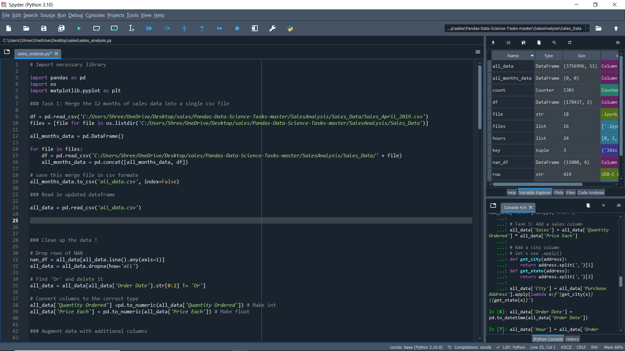
Task 1: Merge the 12 months of sales data into a single csv file .

Slide 5
Clean up the data .
Convert columns to the correct type .

Slide 6
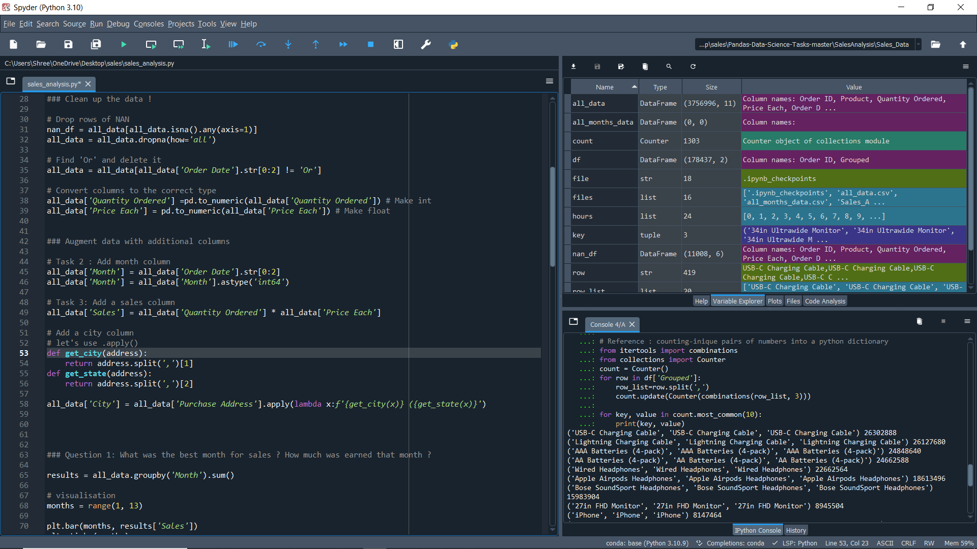
Augment data with additional columns .
Add columns like Month, Sales, City for analysis my data.

Slide 7
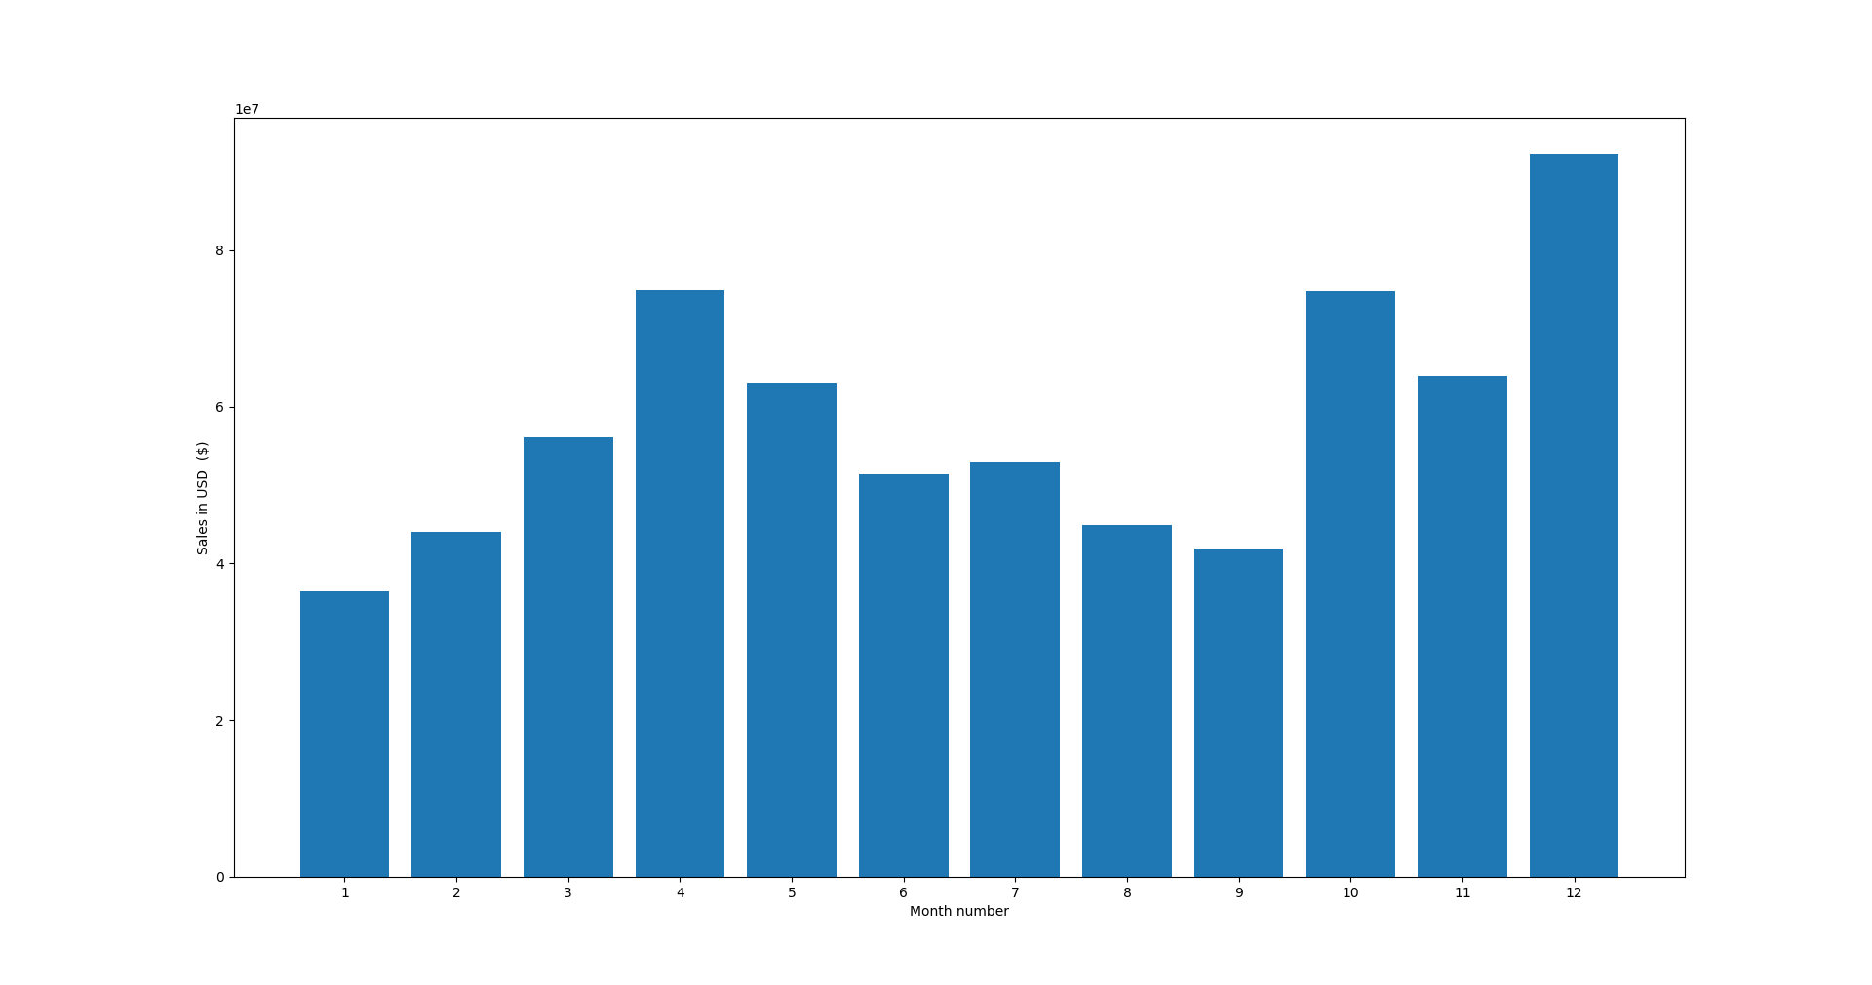
Question 1: What was the best month for sales ? How much was earned that month ?
Ans. December was the best month for sales. 6,151,260 USD was earned in December.

Slide 8
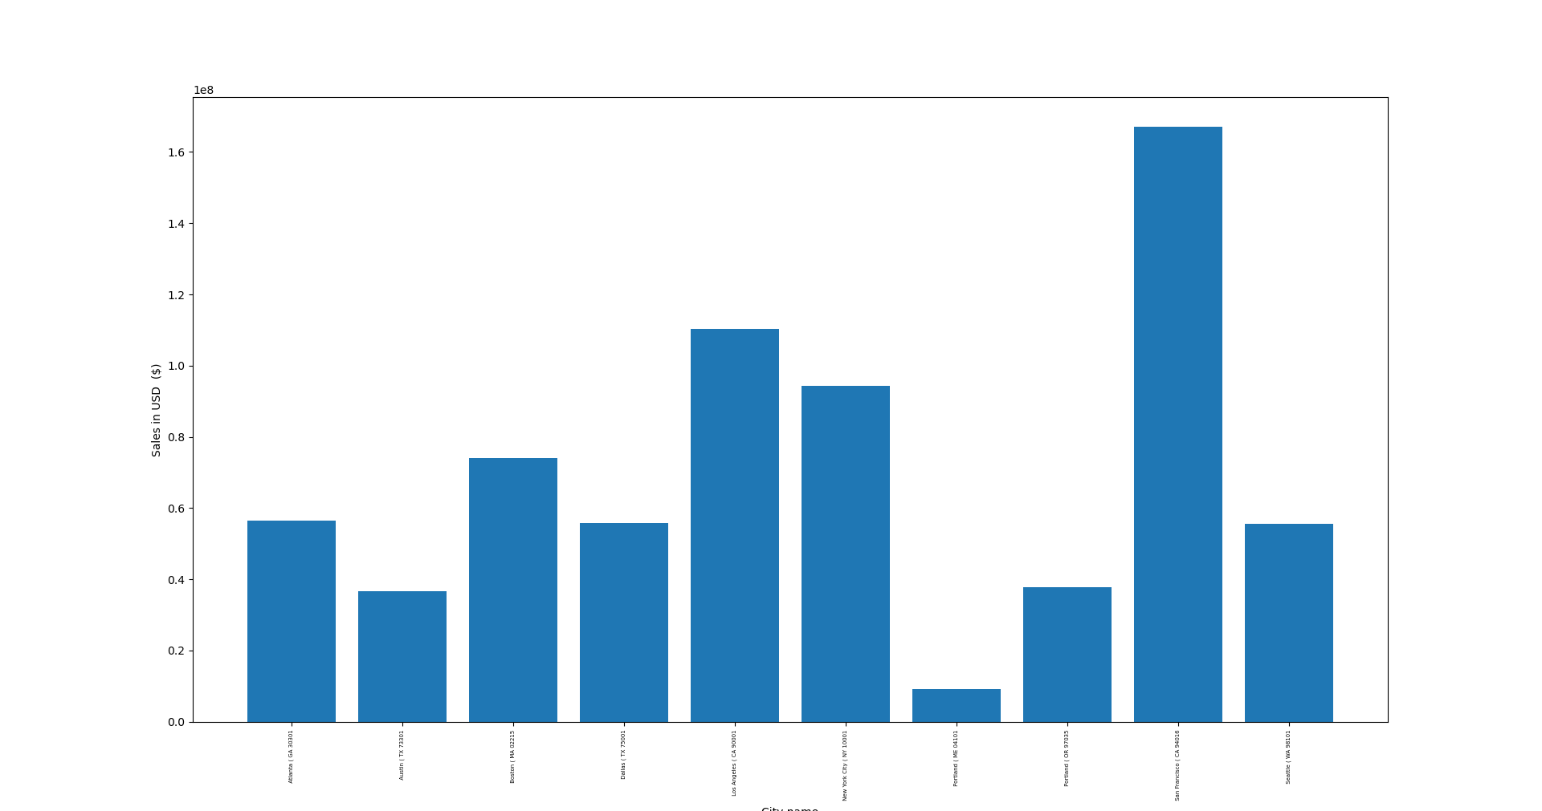
Question 2: What city had the highest number of sales ?
Ans. San Francisco ( CA 94016), this city had the highest number of sales that is 1015092 .

Slide 9
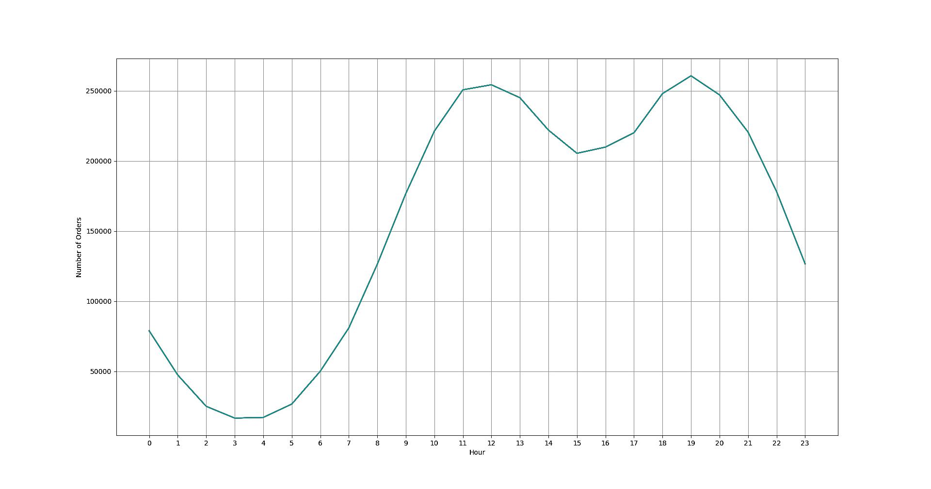
Question 3: What time should we display advertisements to maximize likelihood of customer's buying product ?
Ans. My recommended is around 11am(11) or 7pm(19) should the best time for advertisements .

Slide 10
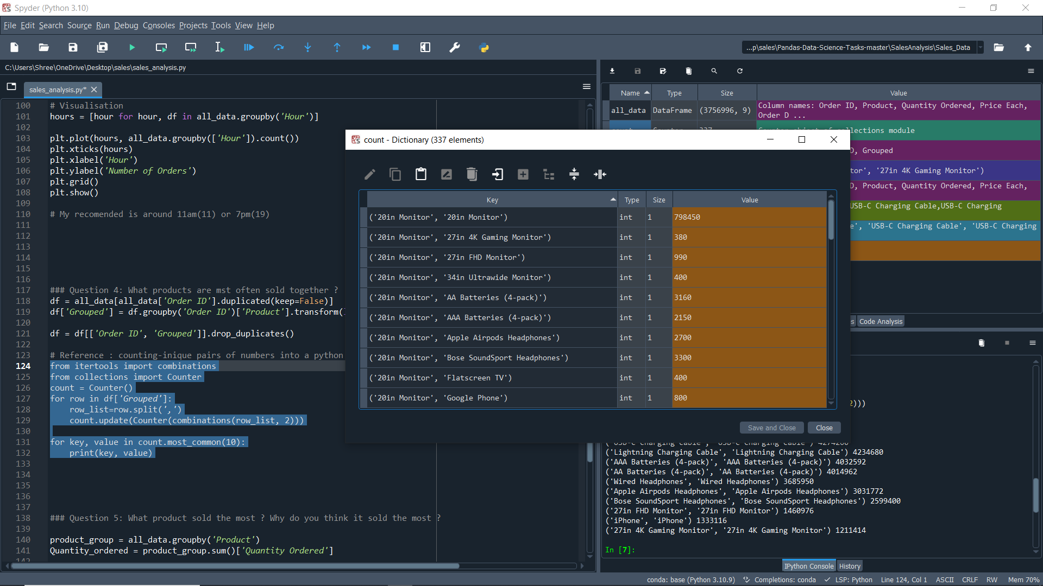
Question 4: What products are mst often sold together ?
From above screen short top 10 combinations of two products that are most often sold together .

Slide 11
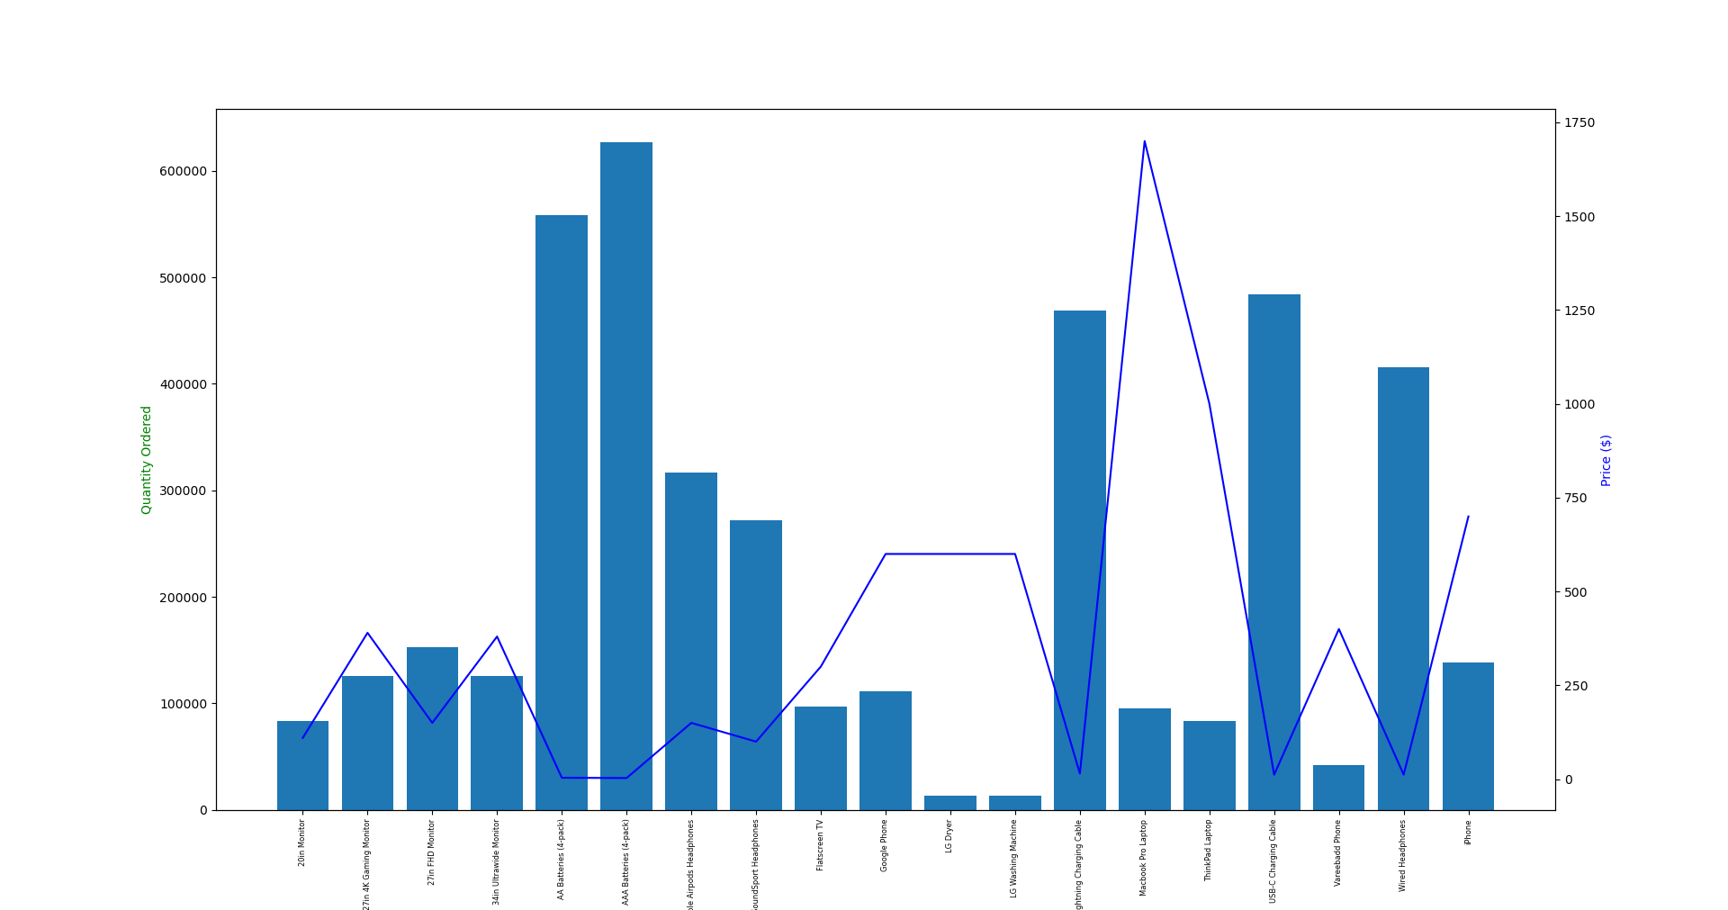
Question 5: What product sold the most ? Why do you think it sold the most ?
From the above chat we see whenever the Quantity Order is high the price should be low . Like LG dryer has high price so it has less Quantity Order and the AAA Batteries (4-pack) has less price , it has high Quantity Order .

Slide 12
THANK YOU
- Pabitra Gana

